Slide 1



Brexit and Belgian customs

Slide 2
Intra-EU trade versus trade with third countries
Intra EU
No formalities
Import – export
Customs formalities
Verification
No verification
No duties
Import duties
No quantitative limitations
Harmonisation
Quantitative limitations
Harmonisation?

Slide 3
Intra-EU trade versus trade with third countries
Effects on your prices and delivery times!
EORI number is necessary
(https://financien.belgium.be/nl/douane_accijnzen/ondernemingen/financi%C3%ABn-bu-ek-eori)
Customs declarations (with required certificates) and establishment of tariff rates
Changes to business processes and software
Checks and inspections are possible
Investments in customs authorizations and customs knowledge

Slide 4
Intra-EU trade versus trade with third countries
Import
ENS
Presenting the goods
Temporary storage
Customs declaration
Arrival of goods
= to bring non-union goods into the EU

Slide 5
Intra-EU trade versus trade with third countries
Export
Place the goods under the export arrangements
Transport from the office of export to the office of exit
Leave the customs territory of the EU
= union goods leaving the EU

Slide 6

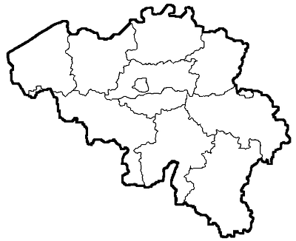

Zeebrugge
Brussel-Zuid
Ports
Antwerpen
Gent
Oostende
Pleziervaart
Airports
Antwerpen-Deurne,
Bierset, Oostende,
Gosselies, Wevelgem,
Zaventem

Slide 7
Notable growth of import and export (UK)
+ 15%
+ 30%

Slide 8




Preparation of the belgian customs administration
Infrastructure
ICT
PLDA
NCTS
Recruitment & training
Equipment
Scanvan
Luggage scanners
(Drone)
Communication plan
General actions
Brexit webpage
Brexit call center
Businesses
National forum
Speakers/seminars
Double interviews
Private individuals
Brochure
Declarations
Officers
Call center
6 FTE’s (+70 2nd line) Available 9:00-16:30
National forum
Import +14% Export
+47%
+291/386
2018 - …
Brexit note august 2019

Slide 9
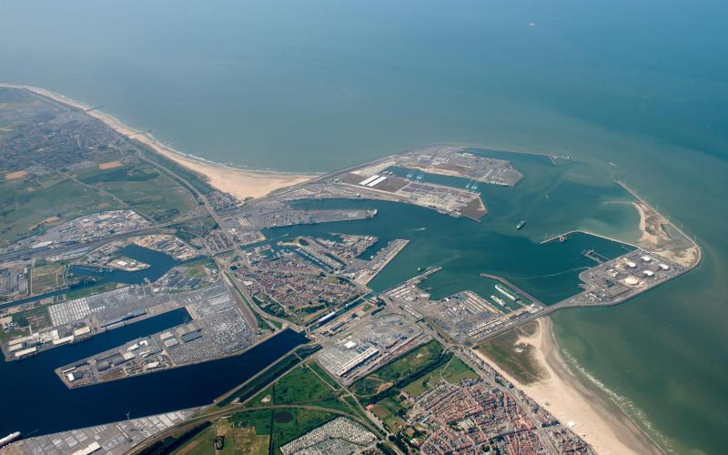

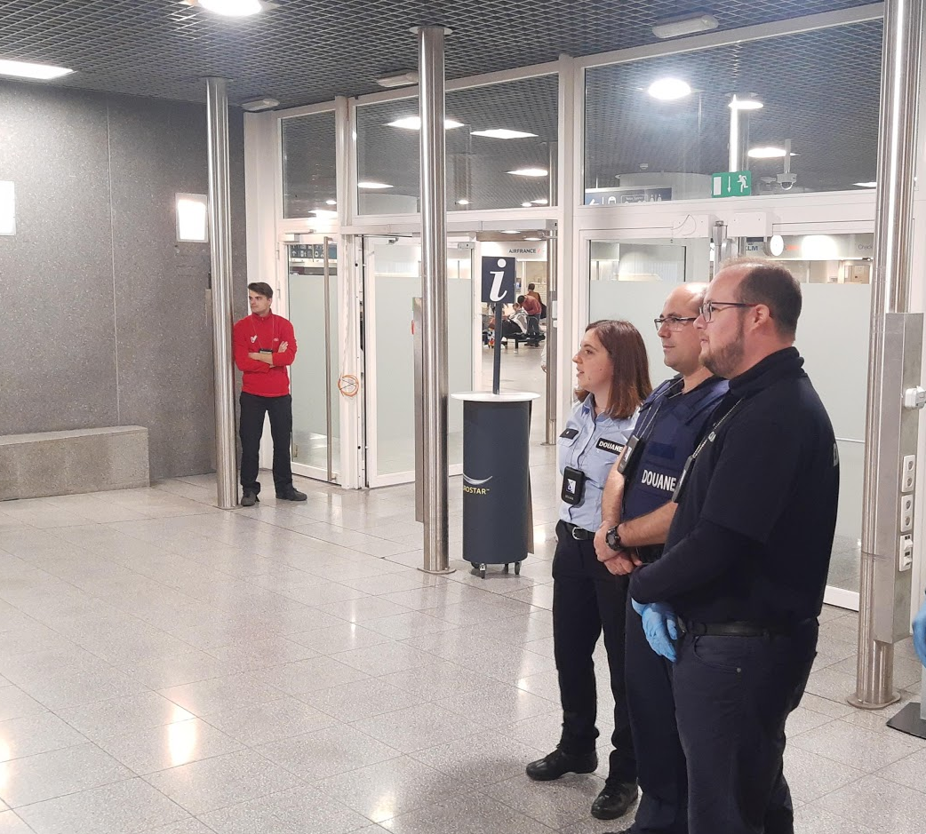
Brexit operational stresstests
Zeebrugge Border Inspection Post
High capacity
Through time max 90 minutes
Congestion risk very limited on customs side
Brussels-Midi train station
New team
Professional attitude
Received training on airports
Additional training and reinforcement for Brexit

Slide 10
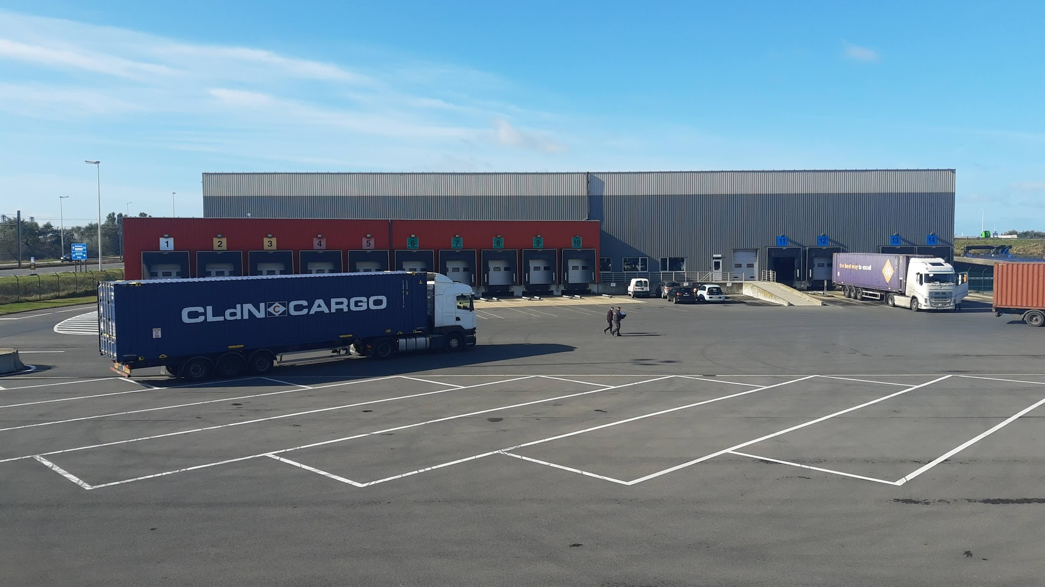

Slide 11
Can you still prepare?
Do the brexit impact scan!
https://brexit-impact-scan.be
Make sure you have your EORI number
https://financien.belgium.be/nl/douane_accijnzen/ondernemingen/financi%C3%ABn-eori/eori
Who will take care of the customs formalities?
Search for a customs broker
https://financien.belgium.be/nl/douane_accijnzen/ondernemingen/douanevertegenwoordiger
Secure your contracts!
Determine the best incoterm!
EXW? How to get your validated copy of the customs decalation by the office of exit?
→ important for VAT purposes to benefit from the VAT exemption
DDP? Customs formalities in the UK?
Apply for an ET 14000 authorisation for the deferment of VAT at import

Slide 12
Belgian ports: practical information
Antwerp:
https://www.portofantwerp.com/en/are-you-ready-for-brexit
Community system: Nxtport
White paper
Zeebrugge
https://portofzeebrugge.be/en/brexit
Community system: RxSeaport
Export and import wizards

Slide 13
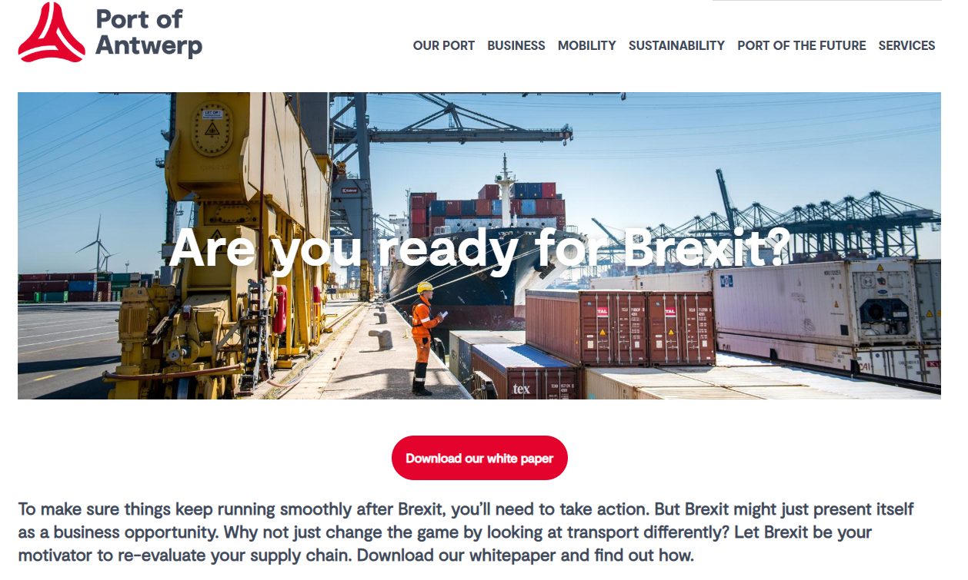
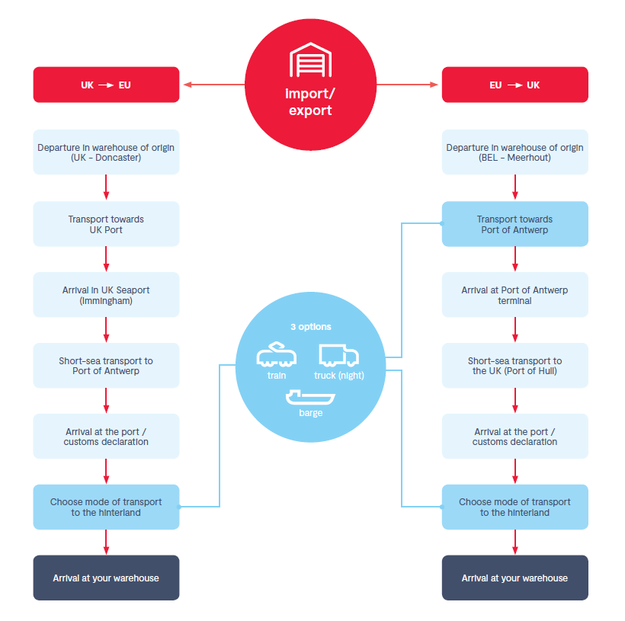

Slide 14

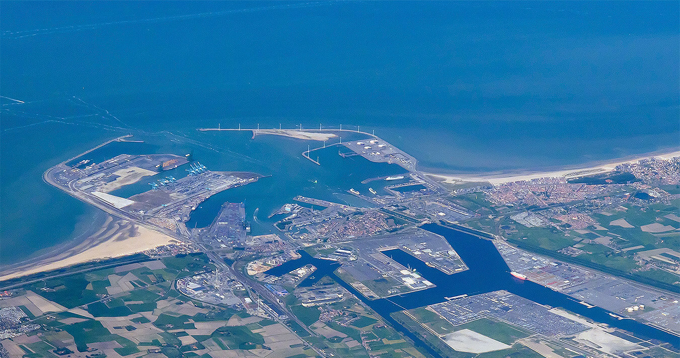
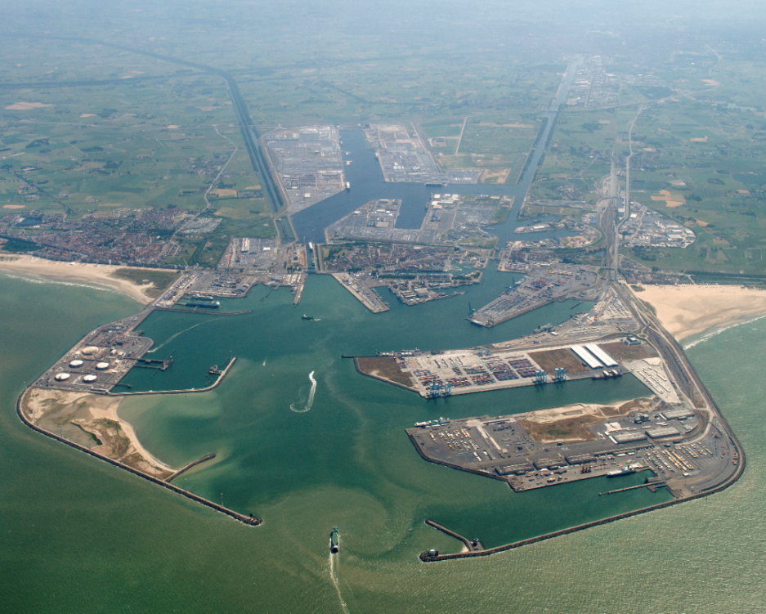
Brexitproof in Zeebrugge
from and to Zeebrugge
In 3 steps
1. BOOKING
Make sure you have a valid booking with your ferry operator
2. CUSTOMS NOTIFICATION
Provide pre-notifications of customs data with RX/SeaPort
3. GREEN LIGHT CHECK
Check RX/SeaPort dashboard if your cargo reached the GREEN LIGHT status

Slide 15
BREXIT CHECKLIST
Start your preparation now so that in case of Brexit you can easily ship goods via the Port of Zeebrugge
Goods flows
Customs formalities
RX/SeaPort
Review your goods flows & logistics
Request your EORI number for customs
Register with RX/SeaPort
Validate your INCO terms
Request the relevant permits from customs
Subscribe to the e-Desk ferry service of RX/SeaPort
Determine who makes the customs declarations in the EU
Contact the Brexit coordinators of customs in case of questions
Subscribe to the RX/Dashboard service of RX/SeaPort
Determine who makes the customs declarations in the UK
Check whether your goods flows are subject to additional checks (FAVV, FAGG,…)
Contact RX/Seaport if you want to set up an EDI connection
Agree who makes the mandatory customs pre-notification with RX/SeaPort
Contact a customs representative if you have no experience with customs
Encourage your truckers to use the “green lights” check on the RX/Dashboard

Slide 16


